Slide 1
Types of planning
4.1 State Space Planning
4.2 Partial Order Planning
4.3 Hirarachaical Planning

Slide 2
Planning with state-space search
Both forward and backward search possible
Progression planners
forward state-space search
Consider the effect of all possible actions in a given state
Regression planners
backward state-space search
To achieve a goal, what must have been true in the previous state.

Slide 3
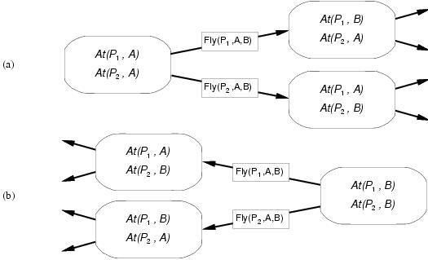
Progression and regression

Slide 4
Partial Order Planning (POP)
See:
Russell, Norvig, AI; chapter 11

Slide 5
Transform Partial Order Plan into Total-order Plan:
Start
Start
Start
Start
Start
Start
Start
Left Sock
Right Sock
Right Sock
Right Sock
Left Sock
Left Sock
Right Sock
Left Sock
Left Sock
Left Sock
Right Sock
Right Sock
Right Shoe
Left Shoe
LeftSockOn
RightSockOn
Left Shoe
RightShoe
RightShoe
Left Shoe
Left Sock
RightSock
Left Shoe
Right Shoe
RightShoe
Left Shoe
Left Shoe
RightShoe
Left
Shoe
Right Shoe
LeftShoeOn, RightShoeOn
Finish
Finish
Finish
Finish
Finish
Finish
Finish

Slide 6
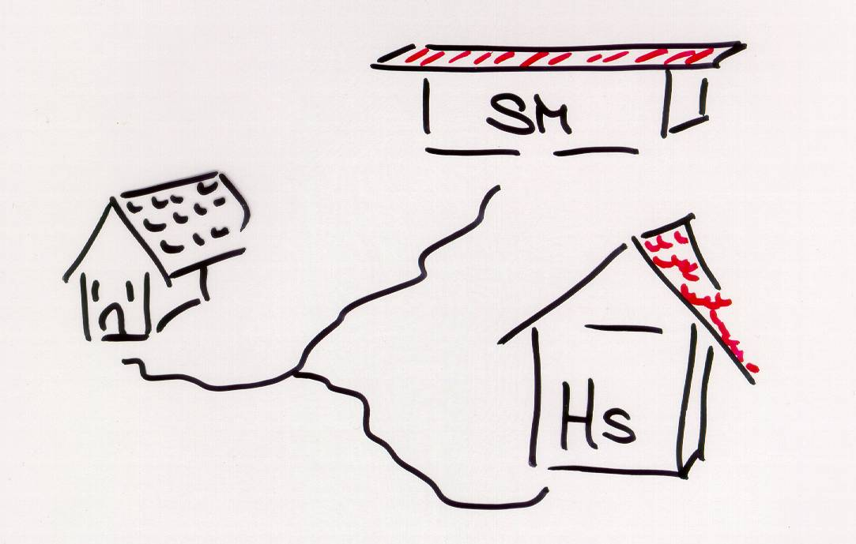
Another Example
At(Home)
Sells(SM, Banana)
Sells(HS, Drill)
Have(Drill)
Have(Milk)
Have(Banana)
SM: Super Market
HS: Hardware Store

Slide 7
Partial Order Planning
Start
At(Home)
Buy(Banana)
Buy(Milk)
Buy(Drill)
Causal links
At(Home)
Have(Banana)
Have(Milk)
Have(Drill)
End

Slide 8
Refining the Plan (1)
NB: all causal links are also ordering links
Start
At(Home)
Ordering links
At(s)
Sells(s,Banana)
At(s)
Sells(s,Milk)
At(s)
Sells(s,Drill)
Buy(Banana)
Buy(Milk)
Buy(Drill)
Causal links
At(Home)
Have(Banana)
Have(Milk)
Have(Drill)
End

Slide 9
Refining the Plan (2)
NB: all causal links are also ordering links
Start
At(Home)
At(SM)
Sells(SM,Banana)
At(SM)
Sells(SM,Milk)
At(HWS)
Sells(HWS,Drill)
Buy(Banana)
Buy(Milk)
Buy(Drill)
Causal links
At(Home)
Have(Banana)
Have(Milk)
Have(Drill)
End

Slide 10
Refining the Plan (3)
Start
At(Home)
At(s)
At(s)
Go(SM)
Go(HWS)
At(SM)
Sells(SM,Banana)
At(SM)
Sells(SM,Milk)
At(HWS)
Sells(HWS,Drill)
Buy(Banana)
Buy(Milk)
Buy(Drill)
At(Home)
Have(Banana)
Have(Milk)
Have(Drill)
End

Slide 11
Refining the Plan (4)
Start
At(Home)
At(Home)
At(Home)
Go(SM)
Go(HWS)
At(SM)
Sells(SM,Banana)
At(SM)
Sells(SM,Milk)
At(HWS)
Sells(HWS,Drill)
Buy(Banana)
Buy(Milk)
Buy(Drill)
At(Home)
Have(Banana)
Have(Milk)
Have(Drill)
End

Slide 12
Threats to Causal Links
Start
At(Home)
At(Home)
At(Home)
Go(SM)
Go(HWS)
At(SM)
Sells(SM,Banana)
At(SM)
Sells(SM,Milk)
At(HWS)
Sells(HWS,Drill)
Buy(Banana)
Buy(Milk)
Buy(Drill)
At(Home)
Have(Banana)
Have(Milk)
Have(Drill)
End

Slide 13
Threats to Causal Links: Demotion
Start
At(Home)
At(HWS)
At(Home)
Go(SM)
Go(HWS)
At(SM)
Sells(SM,Banana)
At(SM)
Sells(SM,Milk)
At(HWS)
Sells(HWS,Drill)
Buy(Banana)
Buy(Milk)
Buy(Drill)
At(SM)
At(Home)
Have(Banana)
Have(Milk)
Have(Drill)
Go(Home)
End

Slide 14
Hierarchical Planning
Russell and Norvig, Chapter 11

Slide 15
Hierarchical Planning
Principle
hierarchical organization of 'actions'
complex and less complex (or: abstract) actions
lowest level reflects directly executable actions
Procedure
planning starts with complex action on top
plan constructed through action decomposition
substitute complex action with plan of less complex actions (pre-defined plan schemata; or learning of plans/plan abstraction)
overall plan must generate effect of complex action

Slide 16
Hierarchical Planning
Hierarchical Planning / Plan Decomposition
Plans are organized in a hierarchy. Links between nodes at different levels in the hierarchy denote a decomposition of a “complex action” into more primitive actions (operator expansion).
Example:
move (x, y, z)
operator
expansion pickup (x, y) putdown (x, z)
The lowest level corresponds to executable actions of the agent.

Slide 17
Hierarchical Plan - Example
Travel (source, dest.)
Take-Plane Take-Bus Take-Car
Goto (bus, source) Buy-Ticket (bus) Hop-on (bus) Leave (bus, dest.)
Goto (counter) Request (ticket) Pay (ticket)

Slide 18
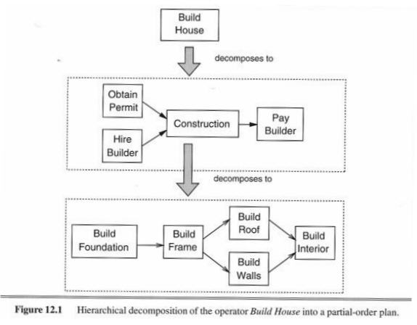

Slide 19
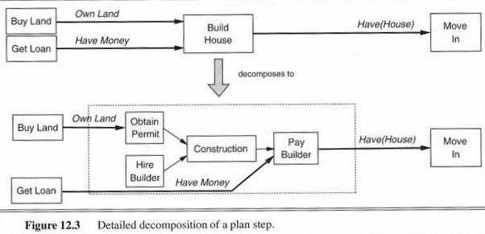

Slide 20
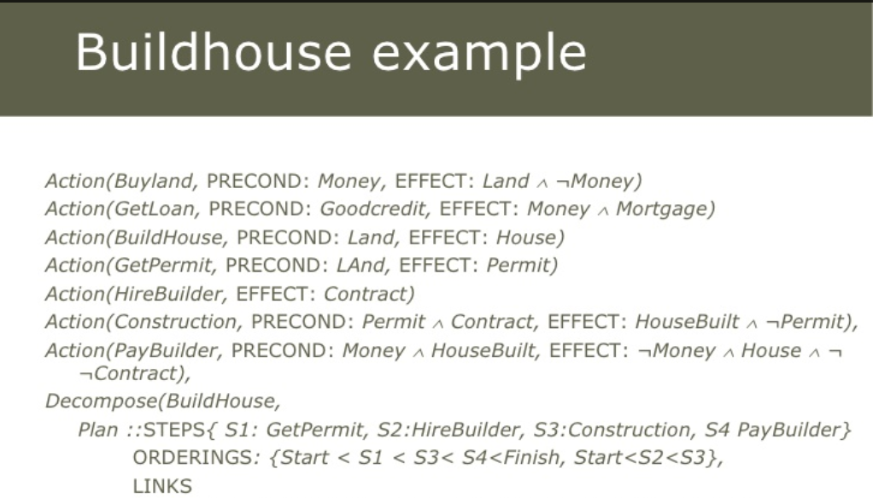

Slide 21
ADL - Action Definition Language
ADL
Can be seen as extension of the STRIPS language.
Contains typing of parameters (sorts).
Allows explicit expression of negation.
Allows equality of terms in precondition formula.
Example:
Fly (p: plane; from: airport; to: airport; c: cargo)
precondition: at(p,to) ∧ at(c,to) ∧ in(c,p) ∧ to≠from
effect: at(p,to) ∧ at(c,to) ∧ ¬at(p,from) ∧ ¬at(c,from)

Slide 22
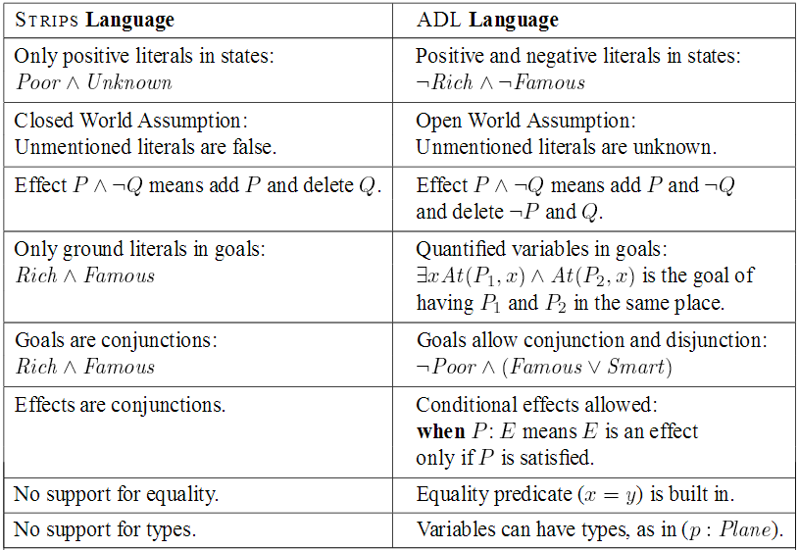
From Russell & Norvig, Chapter 11

Slide 23
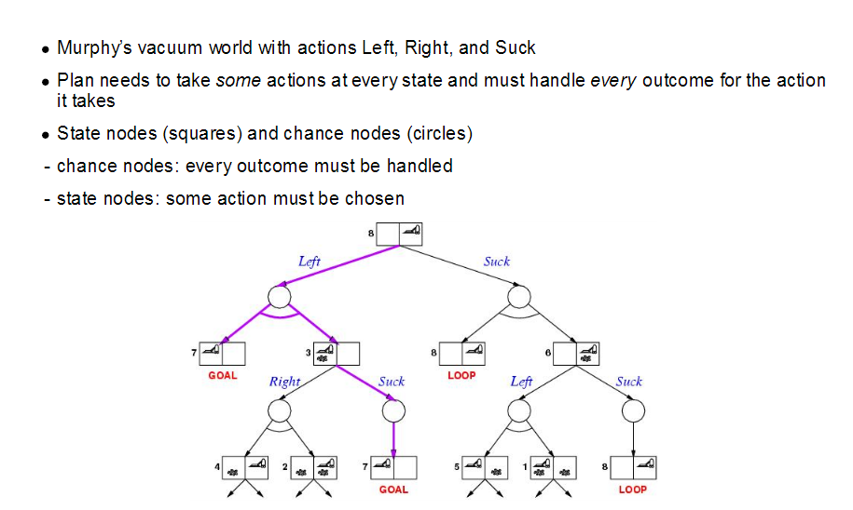
Conditional Planning

Slide 24
